Slide 1
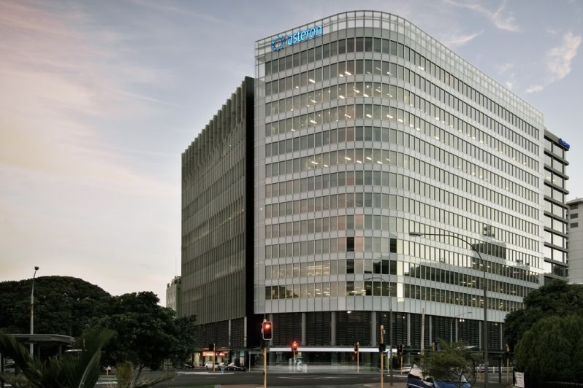
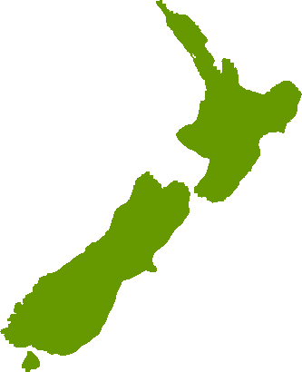
CAA New Zealand
Greg Baum
July 2016

Slide 2
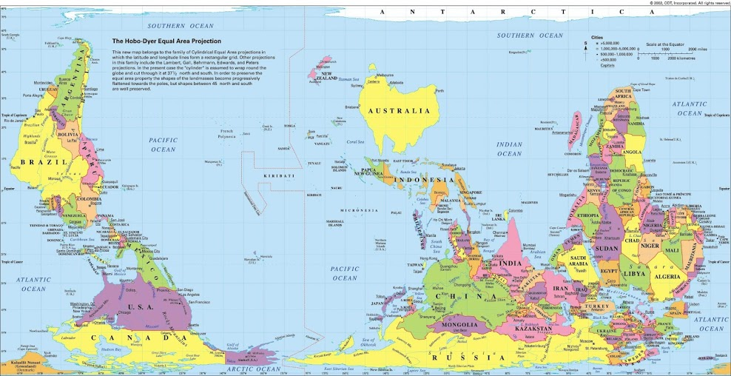
New Zealand
→

Slide 3
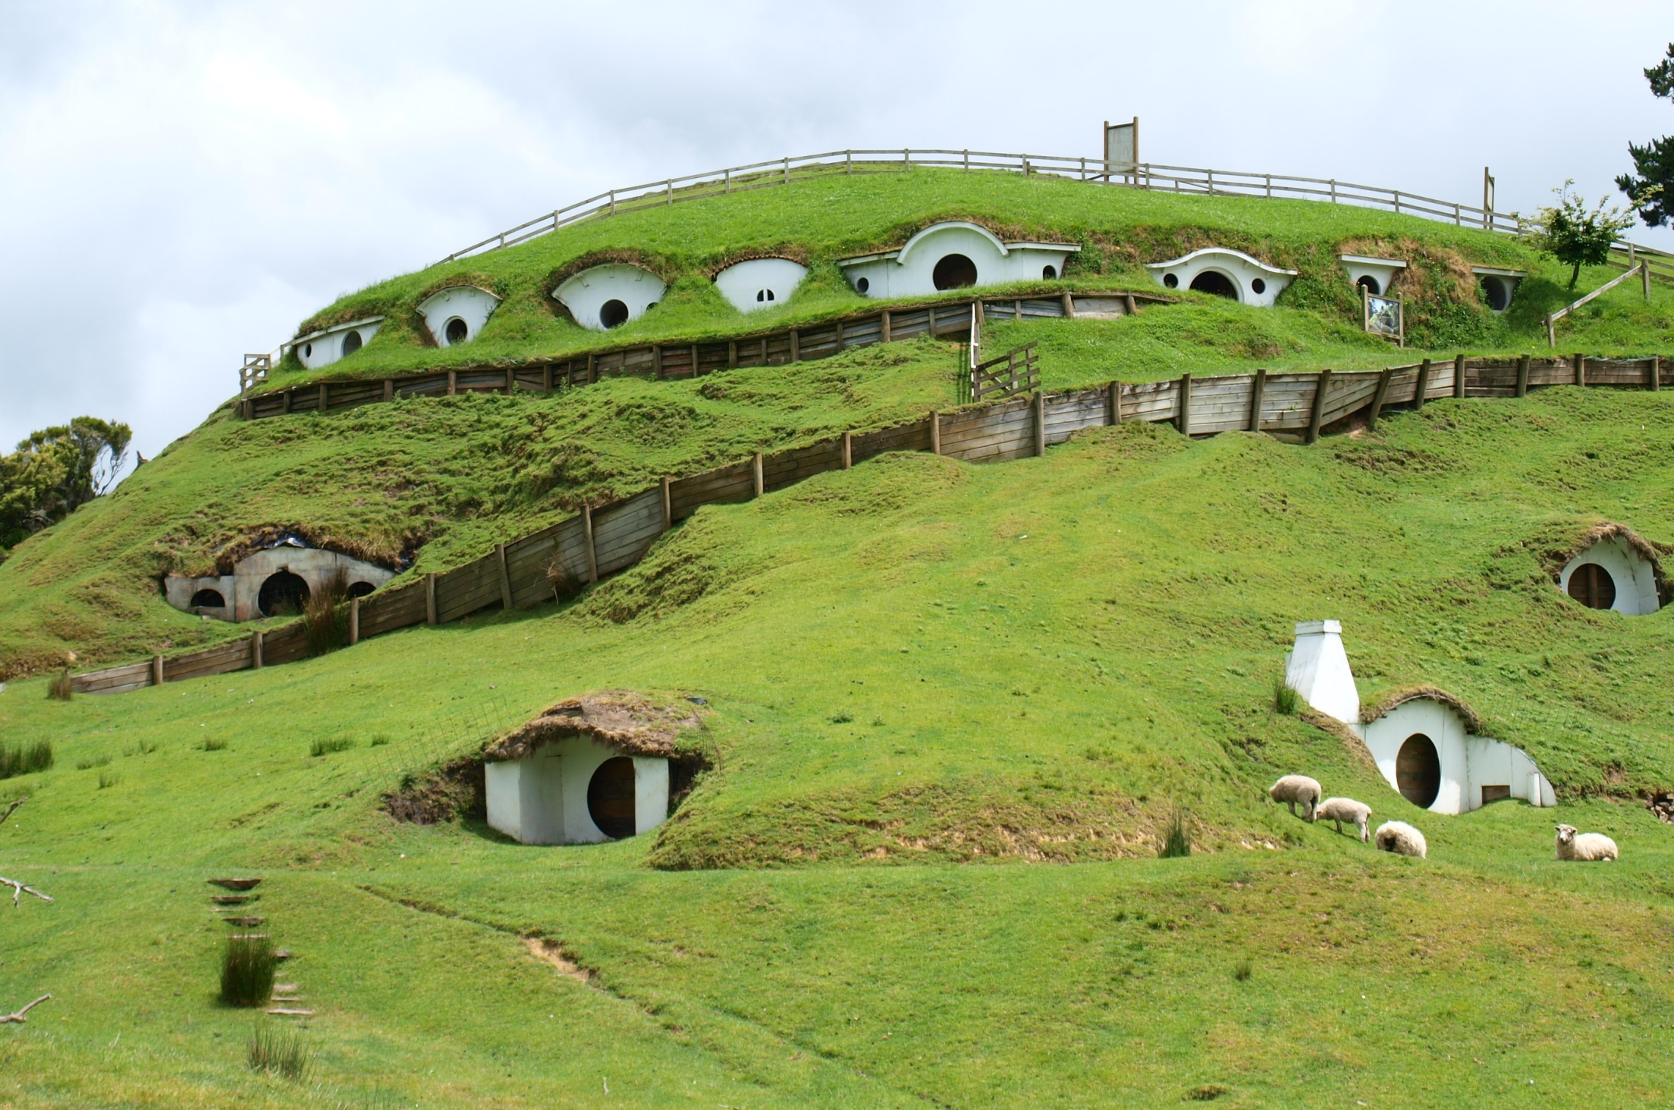
New Zealand

Slide 4
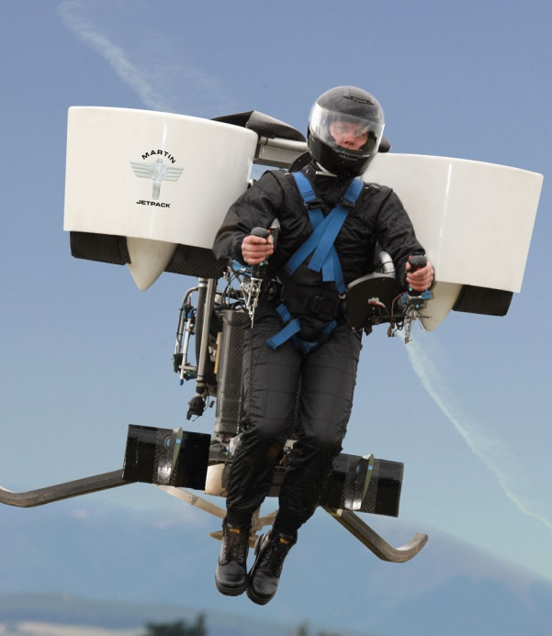
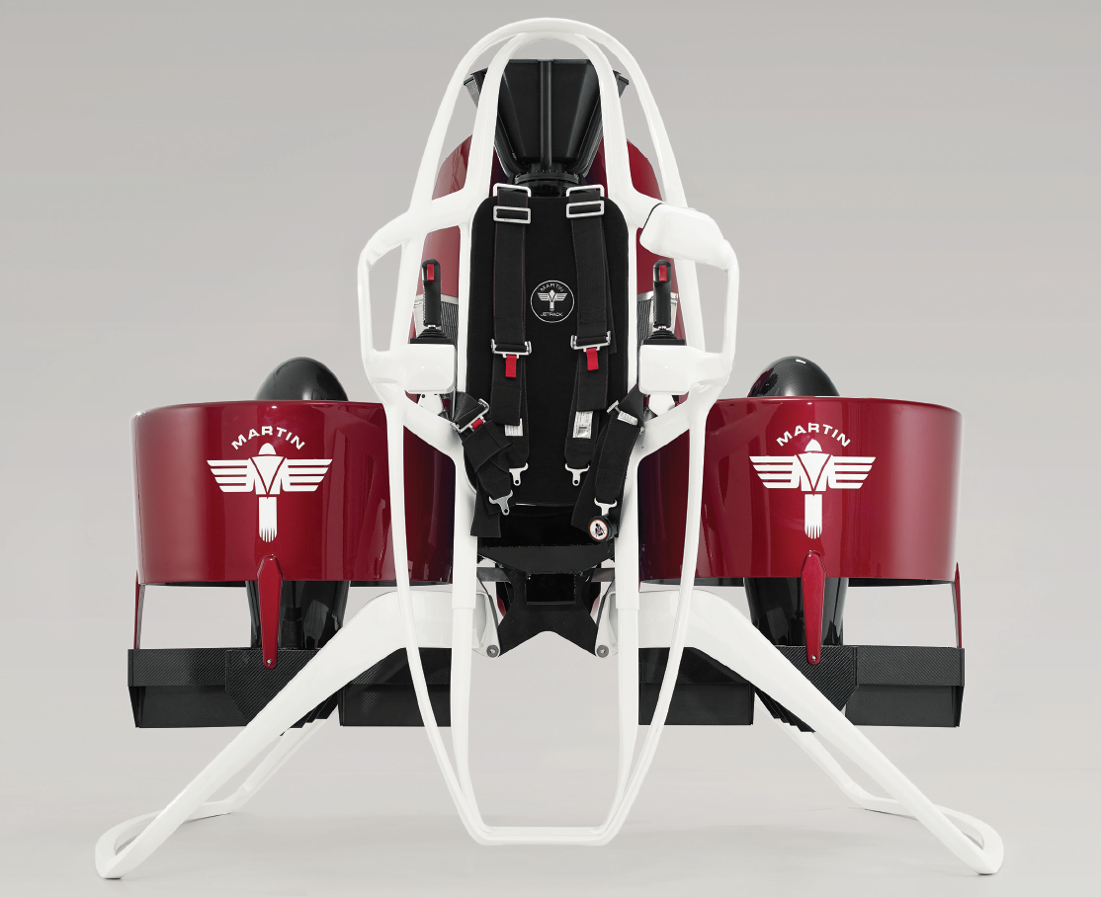
Notes:
Martin Jetpack
Vickers composite amphibious LSA

Slide 5
New Zealand Aviation System
Notes:
CASA
15,300 aircraft (3x NZ)
2,151 heli (2.5x NZ)
US – 320m people, (1 heli per 15.2k people), 320k aircraft, 204k GA, 7k air carrier, 21k helis, 9.87km2 (1 a/c per 31km2) – 6% are helis
NZ – 4.6m people (1 heli per 5.5k people), 0.268m km2 area (1 a/c per 57 km2) – 18% are helis

Slide 6
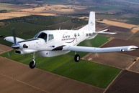
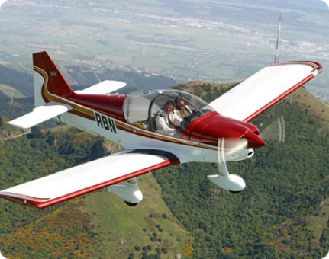
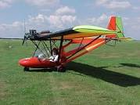
Certification Post 1995 – Part 21
3 new Aircraft Type Certificates
  Pacific Aerospace 750XL (Composite cowling,
  cockpit enclosure, cargo pod, fairings)
  Alpha Aviation R2000 series (composite
  cowlings, fairings)
  B22 Bantam microlight (composite cabin
  fairing)
Approx 380 STC’s
  50% Aircraft Interior Modifications
  25% Helicopter Role Equipment

Slide 7
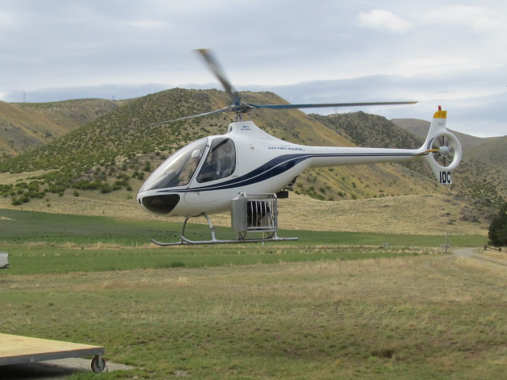
Less typical role equipment
Canine transportation pod
Static/Lightning – “the neoprene sheet under the clamps doesn’t have a thickness specified in the Installation Instructions and metal-metal bonding not included.”
Single point failure – top connection – importance of failure mode analysis.

Slide 8
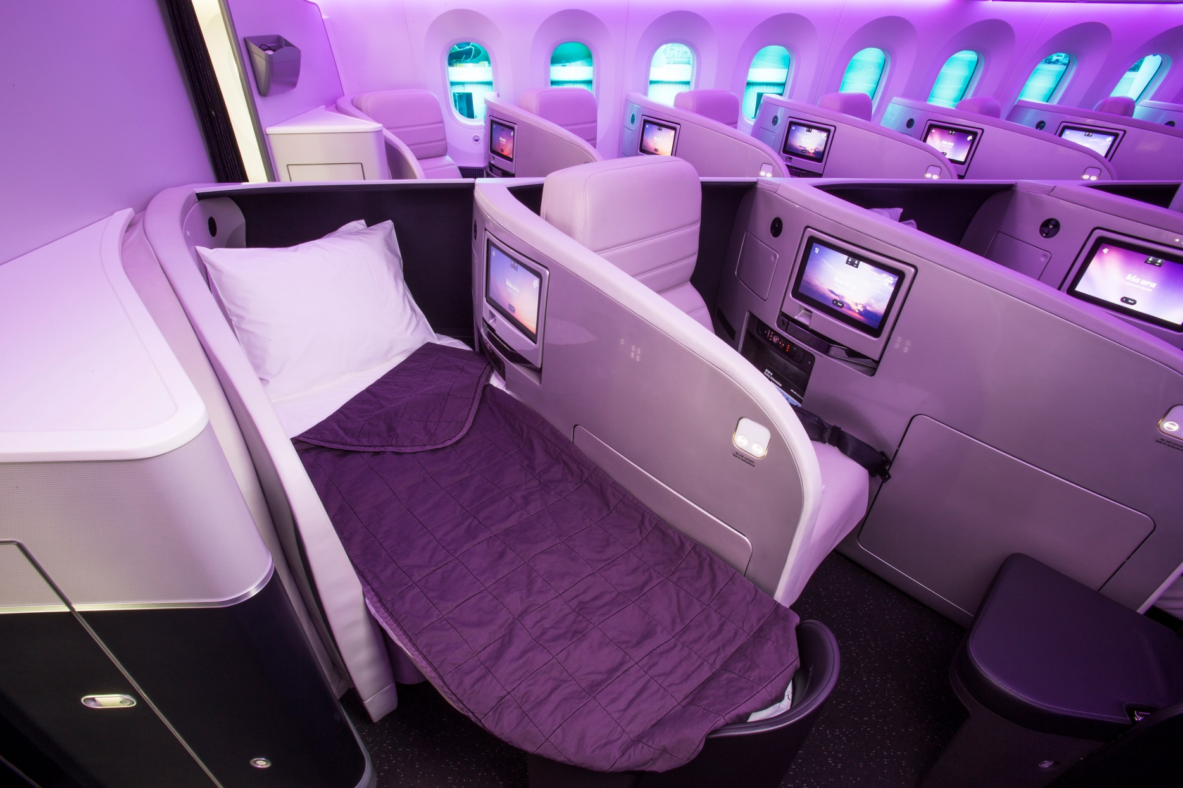
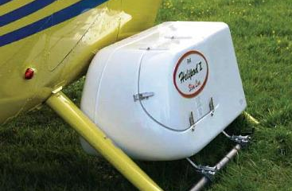
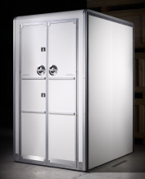
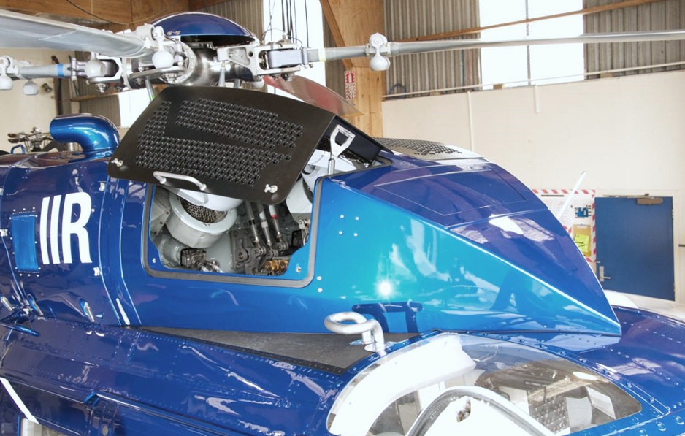
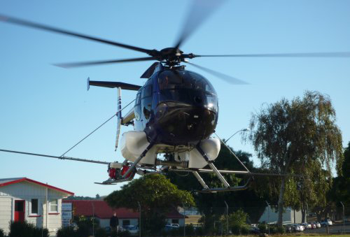
Notes:
Multiple Heli STC
- Spray gear, Bike racks, Particle seperator, camera mounts, hoists & HEC

Slide 9
General Certification Philosophy
Typical Design Certification for modifications (secondary structure)
  Structural testing with load enhancement factors
  Material & Process Specification with level of detail based on criticality
Typical Production Certification
  Manufacture by Company holding Part 148 Manufacturing Organisation Certificate with:
    CAA Accepted Manufacturing Processes
    Quality & Safety management System
Challenges
  NZ isolated – materials & training
  NZ has strong marine industry influence

Slide 10
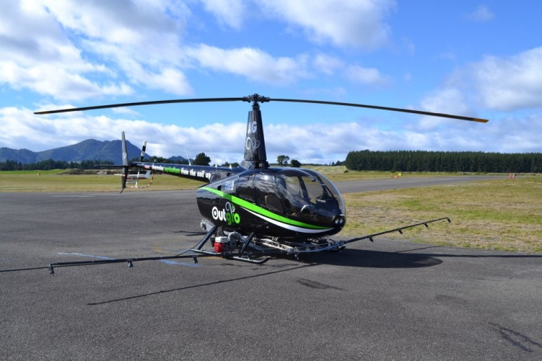
Typical Helicopter Role Equipment
AGRICULTURAL SPRAY SYSTEM
Composite liquid tank
Spun composite spray booms
Welded centre structure
Typically tested to AC27 MG5 load factors.
Adverse affect on safety (603) drives material suitability & durability.
Restricted category, but booms can lead to failure as witnessed on metallic braced booms: “The unrestrained drag brace and the end of the left spray boom were struck by the
main rotor, causing a catastrophic failure of the rotor head.” AS350, Feb 2000
Effects of Environment & Process, to be considered
Notes:
§27.603 Materials.
The suitability and durability of materials used for parts, the failure of which could adversely affect safety, must—
(a) Be established on the basis of experience or tests;
(b) Meet approved specifications that ensure their having the strength and other properties assumed in the design data; and
(c) Take into account the effects of environmental conditions, such as temperature and humidity, expected in service.
R66 spray boom was tested at 30degC and had limitation in FMS. Used Toray prepreg. Tested on 3 year old 1000hr boom.

Slide 11
Special factors approach
Use of Rotorcraft ‘Secondary Composite Structure’ memo
  Static overload factors: 1.5 for environment, 1.3 for material /manufacturing variability
  Design Limit Load x 1.5 FOS x 1.95
  But published in 1998
Other considerations:
  Galvanic corrosion often forgotten
  Layup drawings often good but lacking process details
  Conformity of subcontract parts & materials is challenging to the untrained

Slide 12
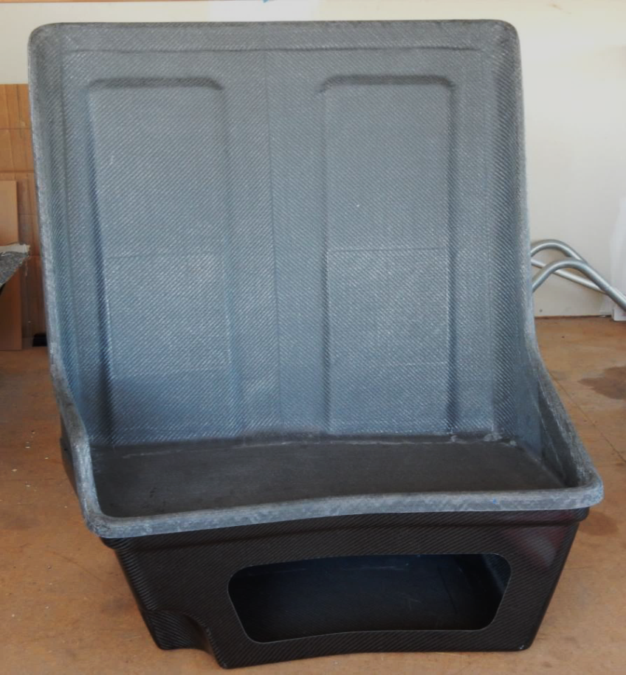
Interior modifications
‘Black metal’ mentality
Requires education:
Not only Design Organisation’s, but wider industry
Post-crash integrity
-> Pre- 27.562 helicopter
-> Lacking guidance on post-crash integrity. Is a successful static test acceptable?
AC20-107B 11a.(2) Airframe design should assure that occupants have every reasonable chance of escaping serious injury under realistic and survivable crash impact conditions. A composite design should account for unique behavior and structural characteristics, including major repairs or alterations, as compared with conventional metal airframe designs.

Slide 13
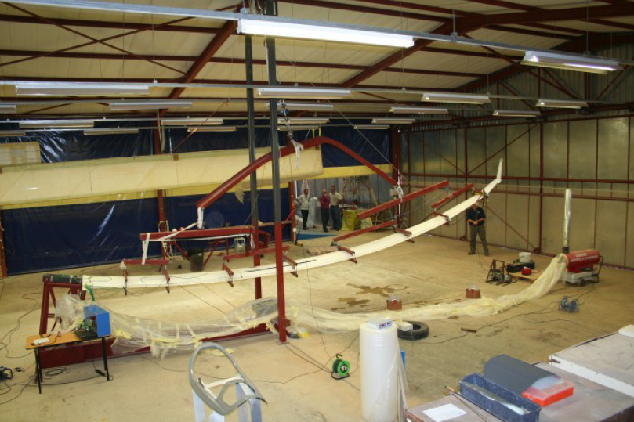
Don’t just design the airframe

Slide 14
Future NZ initiatives
Composite material qualification – shared resources in industry (Callahan innovation)
Encouragement in industry to set minimum training standards
  Work with RNZAF, AirNZ
  Aircraft Maintenance Engineer competency framework

Slide 15
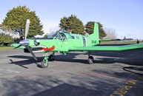
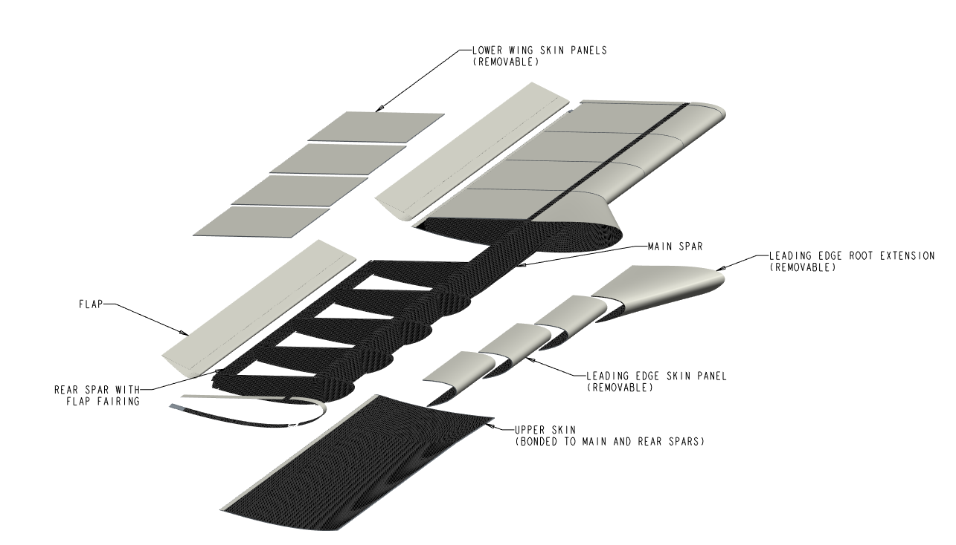
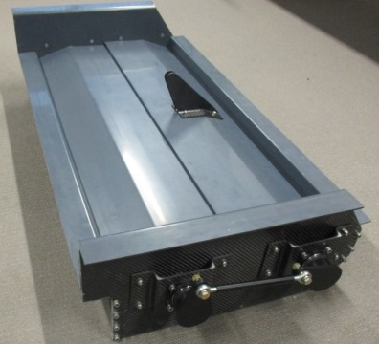
Future Projects
Cresco replacement wing
All bonded structure
Proposed design features:
  Novel main-spar
  Built-in integrity monitoring
15kg hopper gate box
v’s 65kg steel

Slide 16
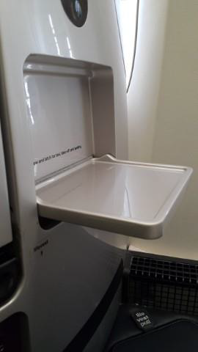
Additive manufacturing
Growth and industry appetite to use it
Significant time advantages compared to OEM spares
Obvious parallels to Composites

Slide 17
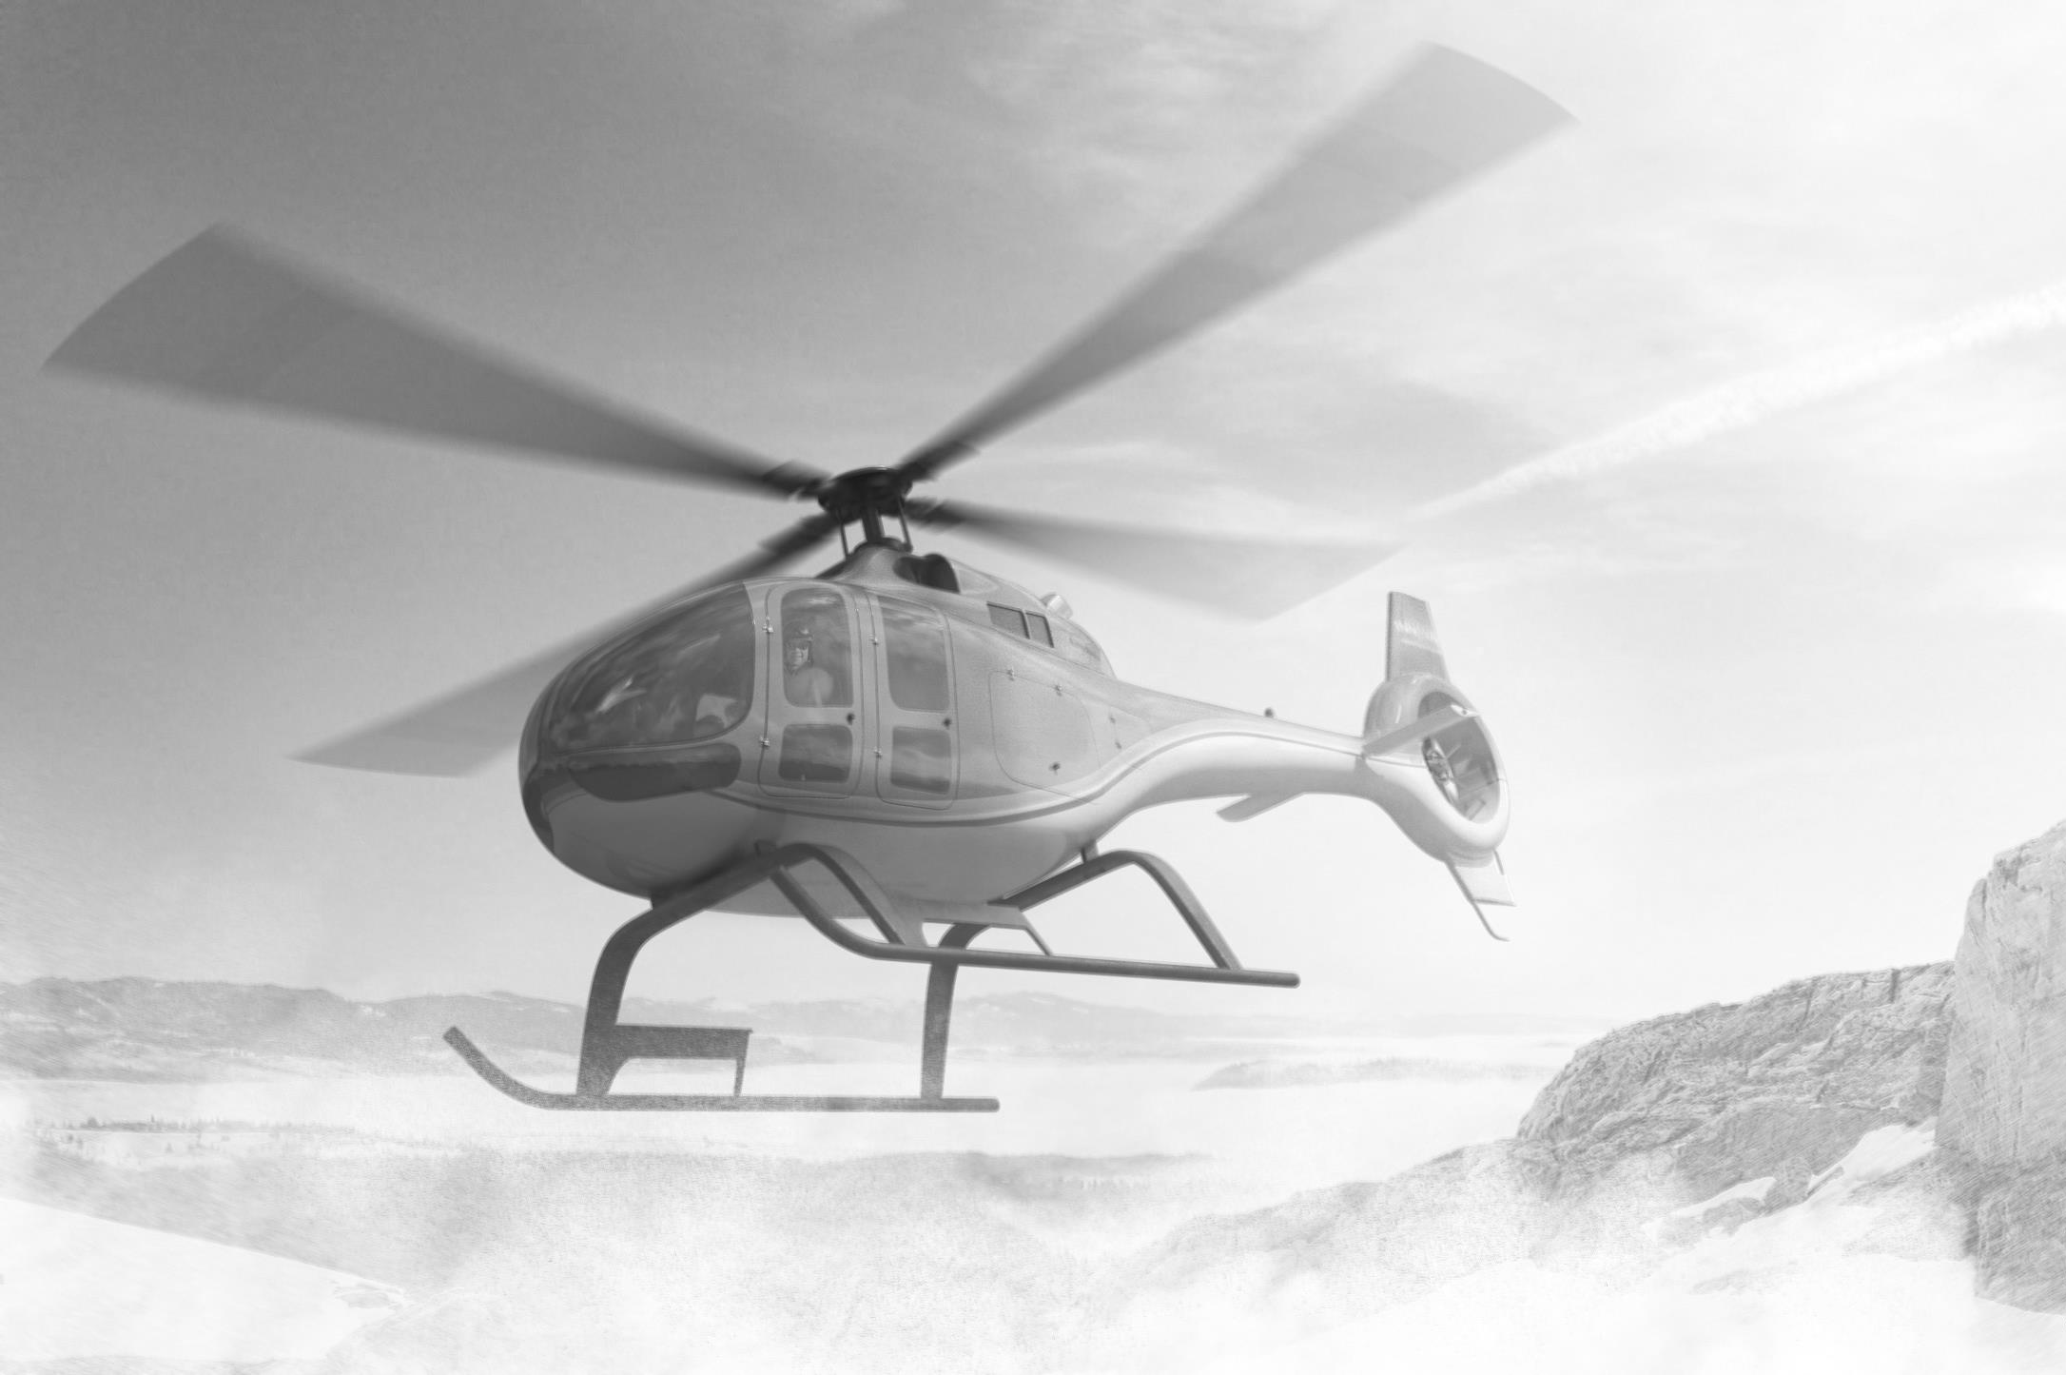
“Engineering is the art of modeling materials we do not wholly understand, into shapes we cannot precisely analyze so as to withstand forces we cannot properly assess, in such a way that the public has no reason to suspect the extent of our ignorance”
AR Dyke at 1946 Chairman’s Address to the Scottish Branch of the Institution of Structural Engineers
Questions

